Slide 1
Hybrid IT: Azure Site Recovery
Benedict Berger

Slide 2


Über den Sprecher
Benedict Berger
Solutions Consultant
Elanity Network Partner in Hannover
Microsoft MVP – Hyper-V
Autor: Hyper-V Best Practices
bb@elanity.de
http://blog.benedict-berger.de

Slide 3
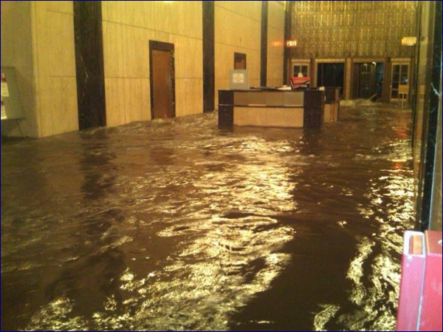
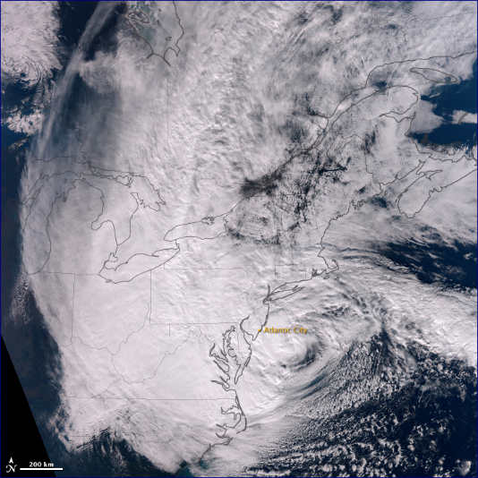
Desaster – Supersturm Sandy

Slide 4
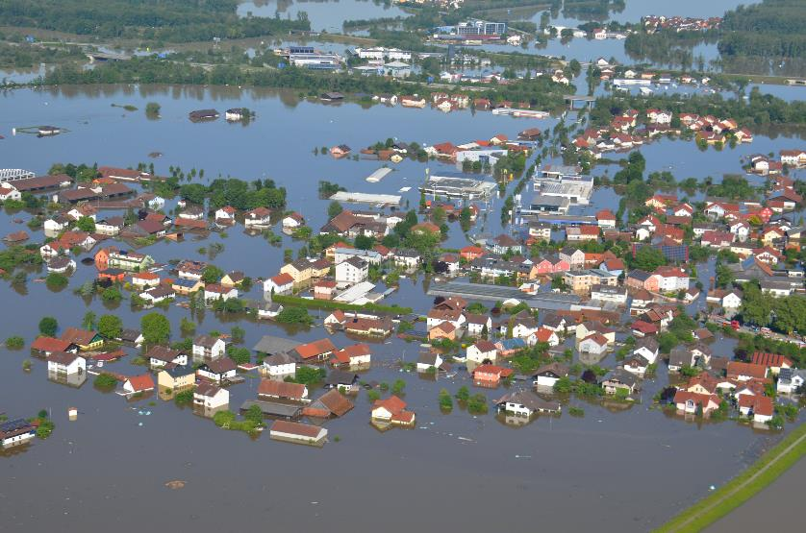
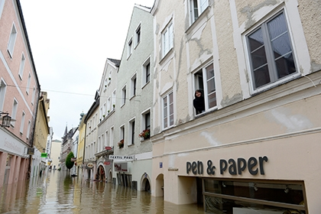
Desaster – Auch bei uns?

Slide 5
Der Bedarf an Business Continuity Auswirkungen aufgrund von Ausfällen im Bereich der Infrastruktur
Notes:
Source: IDC: Measuring Cost of Downtime and Recovery Objectives Among U.S. Firms, IDC QuickPoll Survey July 2013 and Storage User Demand Study 2013

Slide 6
Business Continuity Herausforderungen
Business Continuity
Hindernis
Komplexe Infrastrukturen und Lösungen zur Sicherung der Daten
Immenses Datenwachstum – oft ohne geeignete Absicherung
Aufbewahrungsfristen der Daten (Gesetzgeber, Richtlinien)
Aufwendiges Medienmanagement (Tape, Archivierung)
Nicht getestete DR und Wiederherstellungsprozesse
Höhere Kosten bei steigendem Datenwachstum und Anzahl VM

Slide 7
Microsoft
Azure Site Recovery DRaaS

Slide 8

Schützen Sie ihre Aplikationen On-Premise zu On-Premise Sicherung mit Hyper-V
Microsoft Azure Site Recovery
Kommunikations Kanal
Replikations Kanal: Hyper-V Replica oder SAN Replikation
Windows Server
Primäre Lokation
Recovery Lokation
Windows Server

Slide 9
Schützen Sie ihre Aplikationen On-Premise zu On-Premise Sicherung mit „Anderen“
Microsoft Azure Site Recovery
Download InMage Scout
InMage Scout
InMage Scout
Replikation und Orchestrierungs Kanal: InMage Replikation
VMware/Physical
Primäre Lokation
Recovery Loaktion
VMware

Slide 10
Schützen Sie ihre Aplikationen On-Premise nach Microsoft Azure – System Center optional
Microsoft Azure Site Recovery
Orchestriert und repliziert
Enterprise
& HSP
Windows Server

Slide 11
Schützen Sie ihre Aplikationen On-Premise nach Microsoft Azure – System Center optional
Microsoft Azure Site Recovery
Orchestriert und repliziert
InMage Scout
2015
Enterprise HSP & SMB
VMware/Physical

Slide 12


Azure Site Recovery
Eine Lösung für unterschiedliche Infrastrukturen
Replication
Replication
SAN
SAN
Replication
Hyper-V
Microsoft Azure
Hyper-V
Hyper-V
Hyper-V
Hyper-V
1
Hyper-V zu Hyper-V (on-premises)
2
Hyper-V zu Hyper-V (on-premises) via SAN
3
Hyper-V zu Microsoft Azure
Replication
Replication
Microsoft Azure
VMware/Physical
VMware
VMware/Physical
4
VMware/Physical zu VMware (on-premises)
5
VMware/Physical zu Microsoft Azure
Notes:
What are the different infrastructures that Azure Site Recovery can provide a solution for?
Well firstly, for customers who have multiple sites, or work with a service provider as a secondary site, and Hyper-V is running on both sites, they can take advantage of Azure Site Recovery to orchestrate the replication and recovery between those sites. In that example, the engine of replication will be Hyper-V Replica, an inbox VM replication technology that’s built into Windows Server 2012 and 2012 R2.
<click>
For customers with an investment in SAN technology, that includes replication in the box, through integration with Hyper-V, System Center and Azure Site Recovery, customers can orchestrate the replication and recovery of their key workloads between those sites, this time, harnessing the power of the SAN, through asynchronous or synchronous replication, to transfer data between sites.
<click>
For customers who don’t have a second site, and are running Hyper-V on their primary site, using Azure Site Recovery, customers can orchestrate the replication and recovery of their on-premises workloads, into the Microsoft Azure datacenters, enabling this as a target for failover in the event of a disaster. The engine of replication in this example is Hyper-V Replica.
<click>
What about customers who don’t have Hyper-V within their datacenters? Well, as we mentioned at the start of the presentation, with the acquisition of InMage, under the umbrella of Azure Site Recovery, customers can orchestrate the replication and recovery of key workloads from physical, or VMware-based sites, over to a secondary site, running VMware also. This time, InMage Scout is providing the replication engine, and is transferring the data between the two on-premises locations.
<click>
Finally, just like we saw earlier, where a customers without a secondary location, could use ASR to replicate and recover Hyper-V-based VMs into Azure, with the new InMage technologies, in the future, you will be able to replicate and recover VMware-based VMs into Microsoft Azure. Again, this will be powered by InMage Scout.
<next slide>

Slide 13
Demo: Azure Site Recovery
Microsoft Azure Site Recovery
Orchestriert und repliziert
Enterprise
& HSP
Windows Server

Slide 14
Azure Site Recovery: Weitere Infos
Benedict Berger
How to Stay Calm When the Lights Go Out: Business Continuity in the Real World
http://channel9.msdn.com/Events/TechEd/Europe/2014/CDP-B239
Leveraging SAN Replication for Enterprise Grade Disaster Recovery with Azure Site Recovery and System Center
http://channel9.msdn.com/Events/TechEd/Europe/2014/CDP-B339
Building Disaster Recovery-as-a-Service: New Opportunities for Service Providers with the Azure Pack and Azure Site Recovery
http://channel9.msdn.com/Events/TechEd/Europe/2014/CDP-B319
Microsoft Migration Accelerator and Microsoft Azure Site Recovery Using InMage Scout
http://channel9.msdn.com/Events/TechEd/Europe/2014/CDP-B328
Microsoft Azure Site Recovery: Leveraging Azure as Your Disaster Recovery Site
http://channel9.msdn.com/Events/TechEd/Europe/2014/CDP-B314
Microsoft Azure Site Recovery: Leveraging Azure as Your Disaster Recovery Site
http://channel9.msdn.com/Events/TechEd/Europe/2014/CDP-B314
Planung und Implementierung: http://www.elanity.de/hybrid-cloud

